Slide 1
Supplier Collaboration System
Jeremy Mordecai 23-0568

Slide 2





Table Of Content
INTRODUCTION
PROBLEM STATEMENT
OBJECTIVES
JUSTIFICATION
PROPOSED SOLUTION
RESEARCHED QUESTIONS
SCOPE

Slide 3






INTRODUCTION
The Service Desk is a system that allows administrators and users to raise incidents, request assistance, and share
information within an organization. It streamlines the query resolution and timely coordination of business processes in an organization. Administrators have more access to the
system and are equipped with tools like Any Desk that allow remote access to users’ devices to solve issues even with
geographical disparity.

Slide 4


PROBLEM STATEMENT
The existing system relies on a ticket system to raise incidents and await approval for the purchase of items.
After approval, a technician makes orders through calls, asks for the availability of the item, and manages receipts independently. This, however, slows down the resolution of the issue and the procurement process altogether.
The existing system lacks real-time communication with suppliers, which slows business processes in terms of communication of inventory availability and quotation.
The existing system does not notify the Service Desk technicians on the delivery of orders.
The current system also depends entirely on Service Desk technicians to request approvals of purchase which slows down the resolution of the tickets.

Slide 5

OBJECTIVES
To develop a dashboard for making orders, tracking order fulfillment, inventory availability, and communication tools with suppliers.
To automate the purchase process and direct communication of product specifications to suppliers from the ServiceDesk.
To automate the performance metrics of suppliers through SLA contracts, accuracy in product delivery, quotations, and quality assurance.

Slide 6
JUSTIFICATION
The proposed system streamlines the purchase process by reducing the time and cost associated with order placement. The system provides a platform to send the product specifications asking for its
availability via the communication tools provided. It also analyzes the suppliers according to their
performance and response time. The system automates the submission for approval and notifications to ease the purchase process.

Slide 7




PROPOSED SOLUTIONS
This system proposes the following:
A coordination between ServiceDesk and supplier
collaboration for purchases via mail or WhatsApp to ease order management, inventory availability, documentation, and communication between the organization and suppliers.
Real-time communication on order fulfillment to speed up
ticket closure/resolution.
Enable suppliers to receive, confirm, and update order statuses.
Automation of submission for approvals in the ServiceDesk.

Slide 8





RESEARCH QUESTIONS
1. How does the organization vet the suppliers’ performance and
check quality assurance?
2. What key features can be required to improve the current system in
order fulfillment and purchase process?
3. How does the supplier collaboration system impact the
overall performance of the ServiceDesk?

Slide 9
SCOPE
The system will interact mainly with the following: Suppliers
Administrators
Technicians
Procurement officer (finance department)

Slide 10
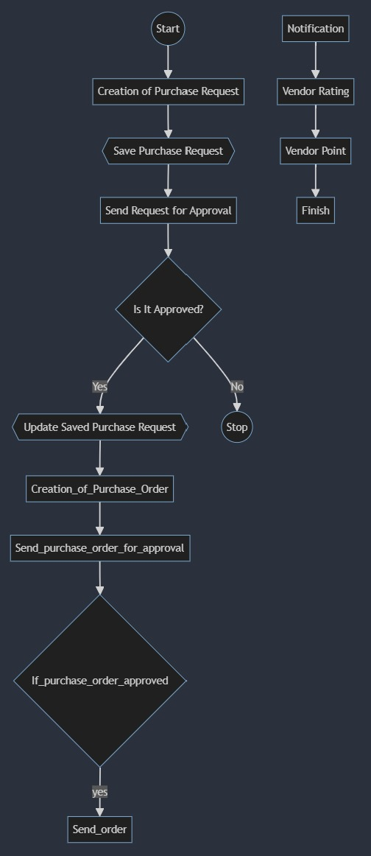
FLOW CHART

Slide 11
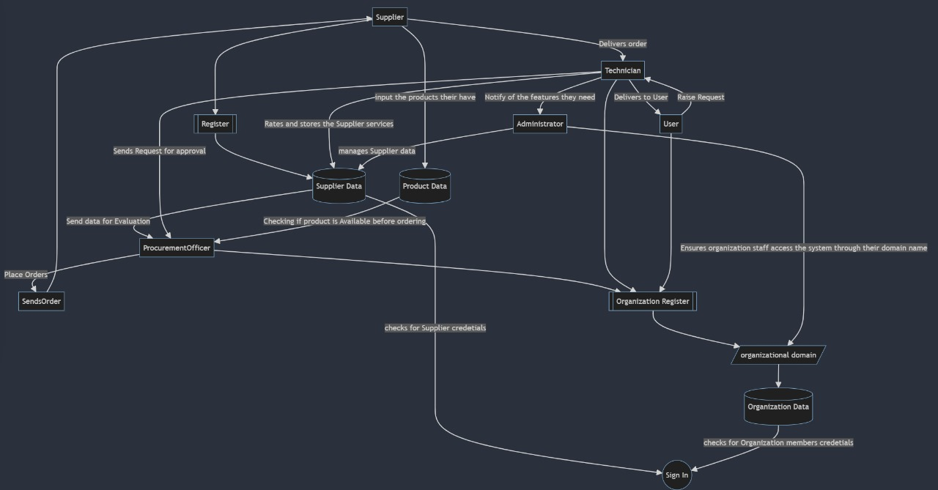
DATA FLOW DIAGRAM

Slide 12
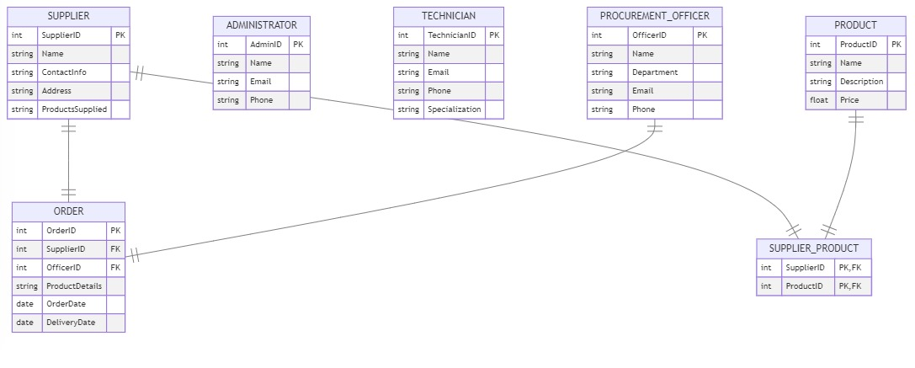
ER DIAGRAM

Slide 13






THANK YOU
ANY QUESTIONS?

